Slide 1
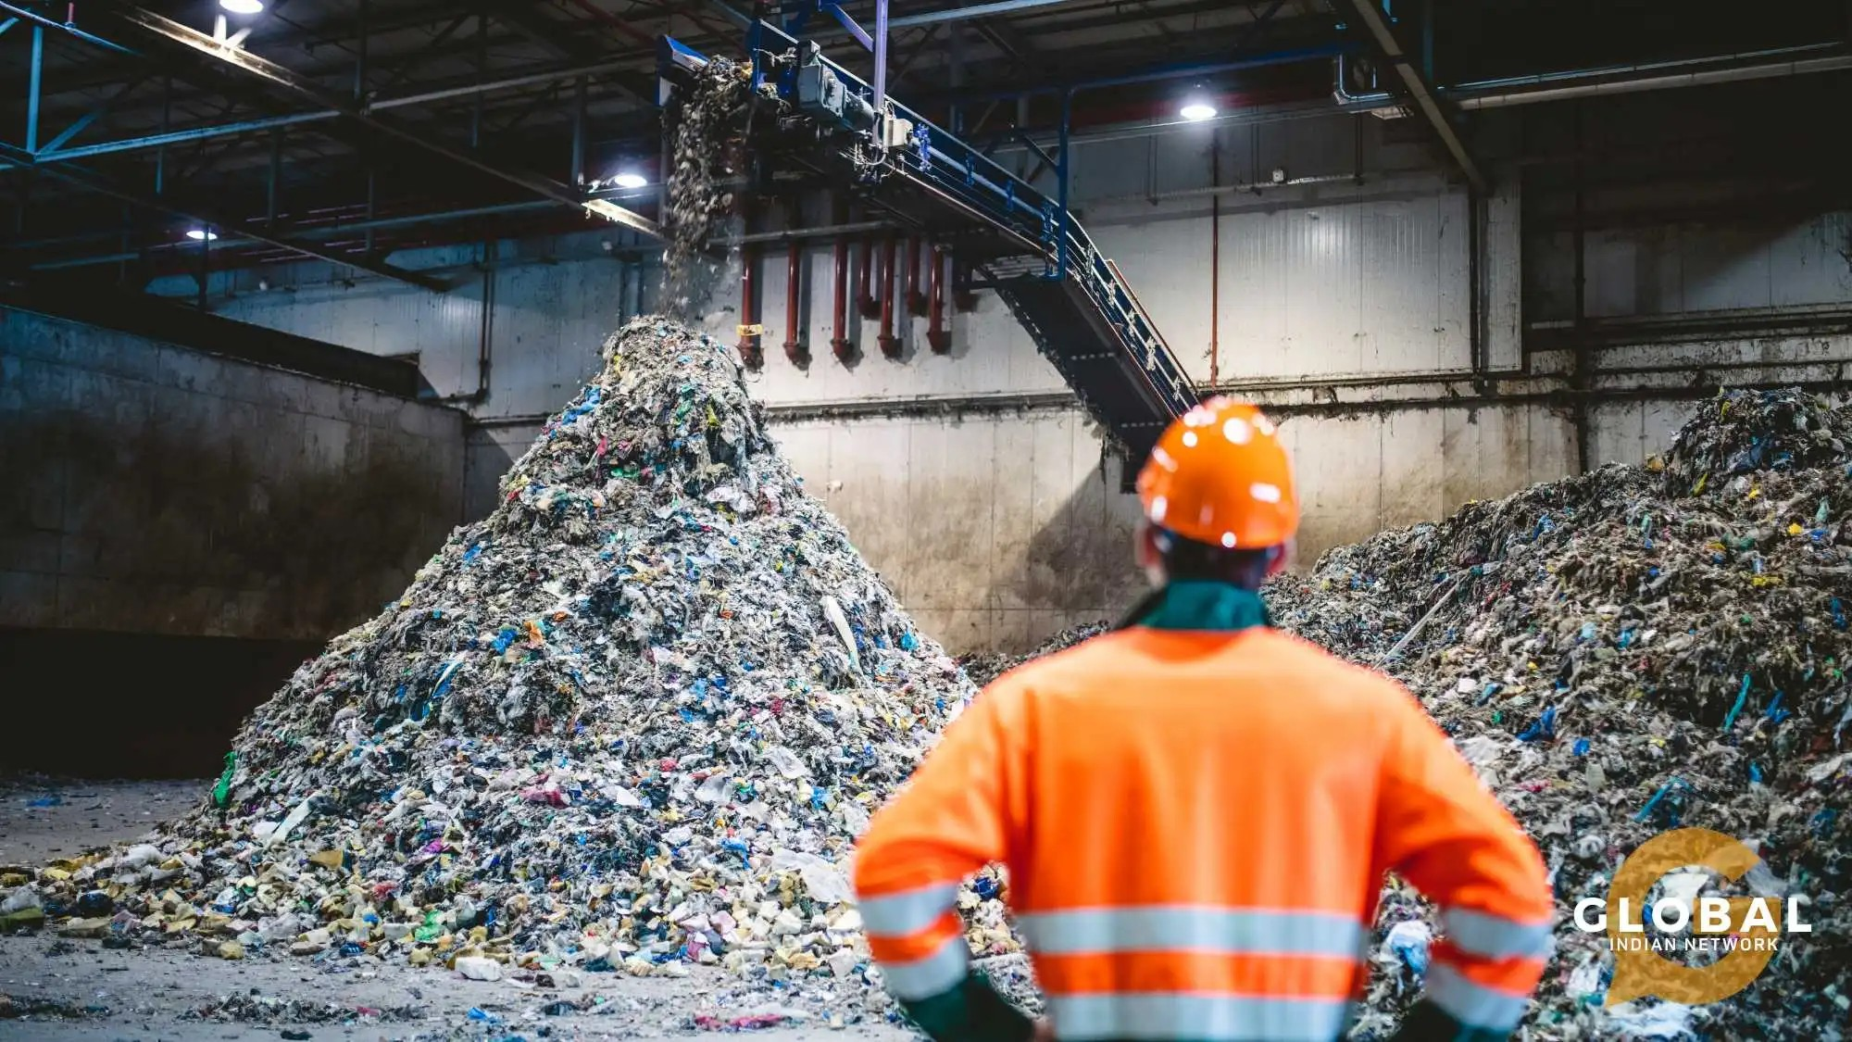
SymbioLink AI
Turning industrial waste into opportunity
An AI-driven platform that matches industrial waste with the units that need it, before it ever reaches a landfill.
Team Name: Team Chaos
College Name: RMD Engineering College
Lead Name: Vishwa R

Slide 2
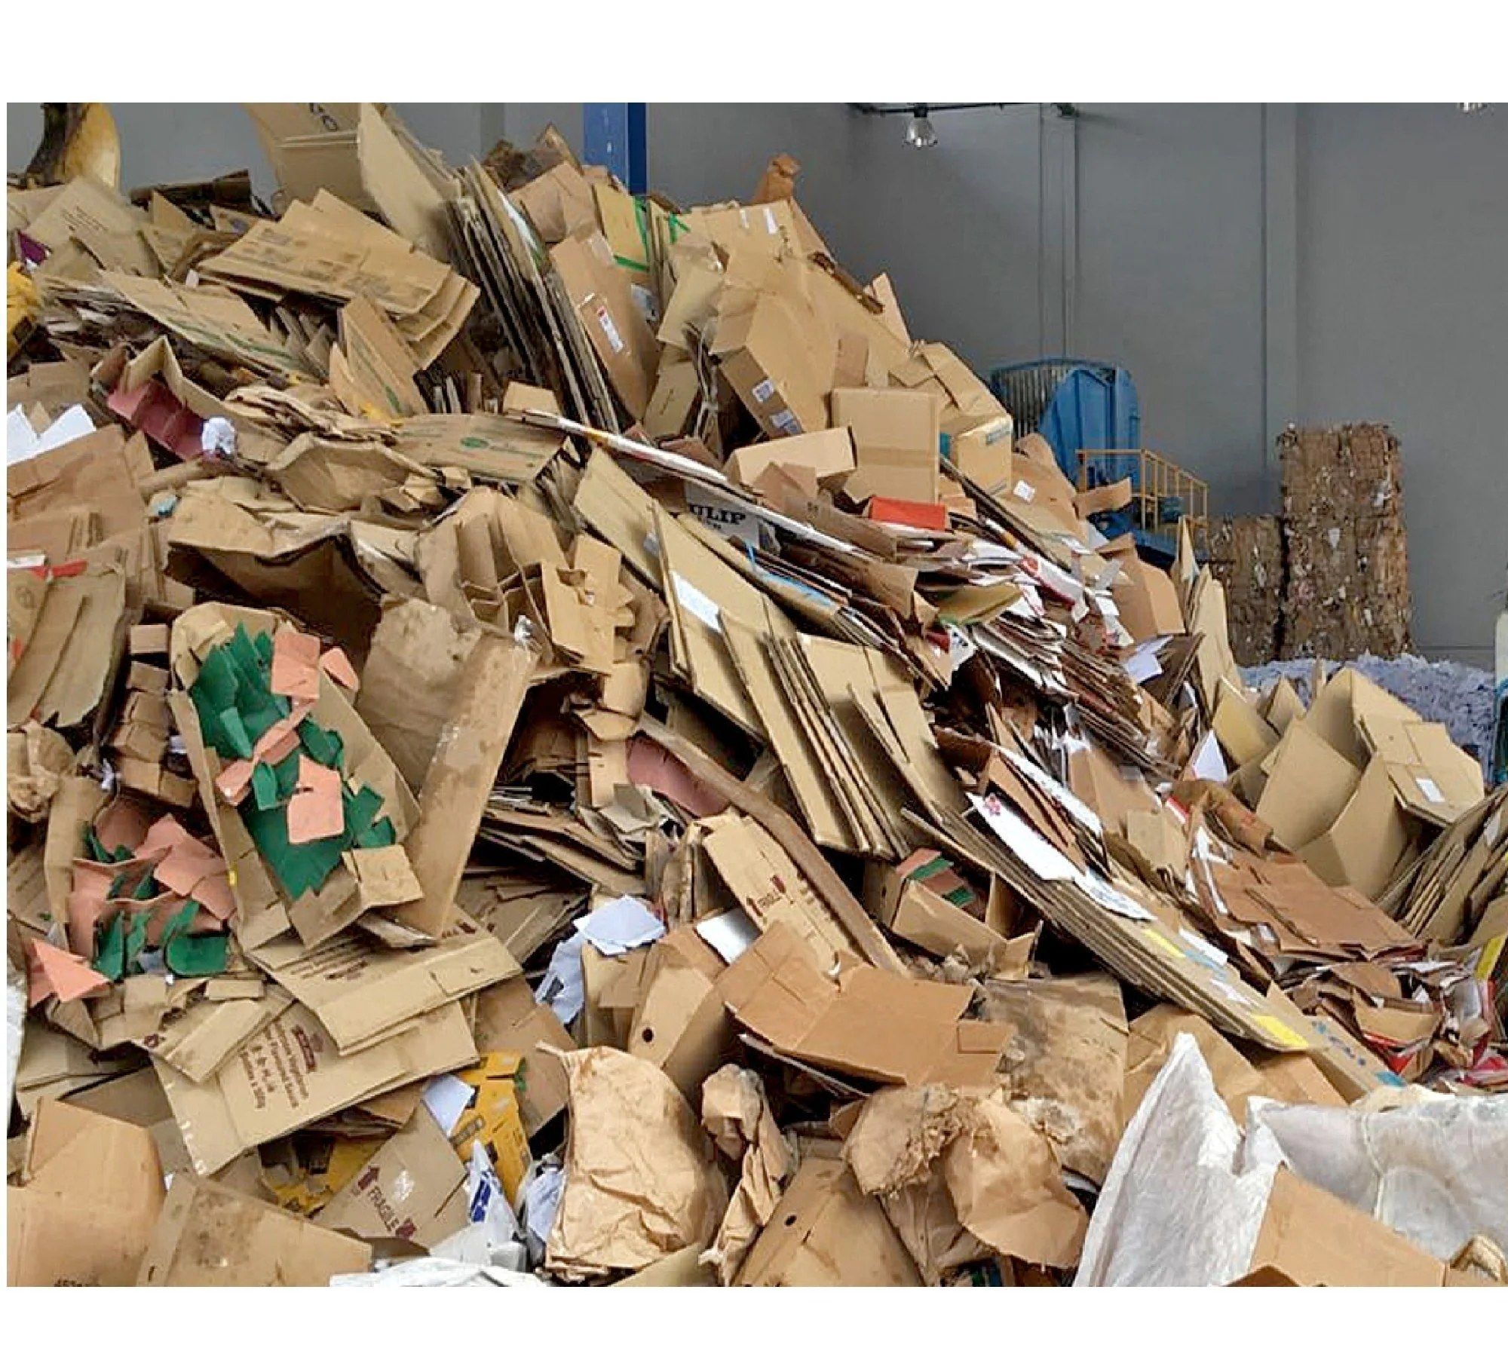
Problem Statement
Two real units, same industrial cluster. Shivam Metal Works produces metal shavings every week — sold to a scrap dealer for a fraction of its value, or landfilled. Two streets away, Ganga Alloy Casting needs metal shavings every week for its casting line, and pays full price for fresh material. Neither knows the other exists.
Industrial clusters generate huge volumes of usable byproducts that could substitute for another nearby unit's raw-material purchase. Most of it is landfilled or sold cheap instead, for three compounding reasons:
1
Small loads get skipped. A solo pickup truck isn't economical for 30-50kg, so low-volume matches are abandoned even when profitable.
2
No way to judge a stranger. Units avoid new, unfamiliar counterparts since there's no track record to check before committing.
3
Zero adoption friction allowed. Most MSME owners won't learn new software — intake has to be as simple as a WhatsApp message.
Cardboard and mixed packaging waste stockpiled at a recycling facility.
02

Slide 3
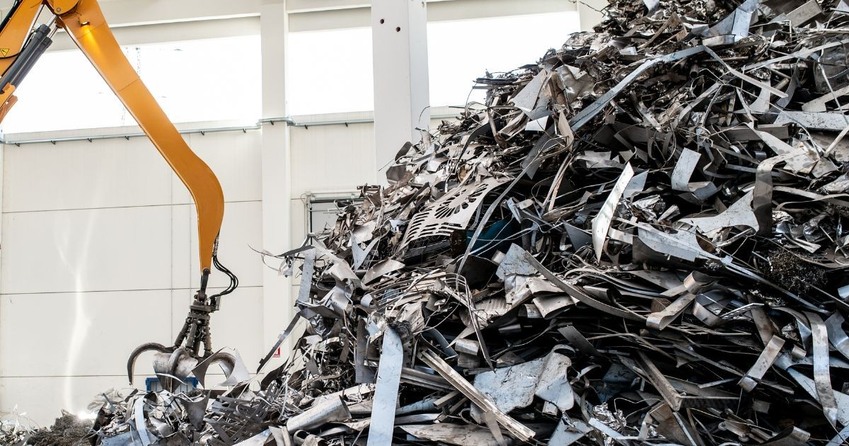
Existing System
How industrial waste exchange happens today — informal, unreliable, and value-destroying:
1
Word of mouth — Matches depend entirely on who happens to know who — most usable byproducts never get discovered at all.
2
Scrap dealer resale — Waste is sold at a fraction of its value to a middleman instead of substituting a purchase another unit would make.
3
Informal WhatsApp groups — No structure, no search, no way to verify a stranger before agreeing to a pickup.
4
Landfill / incineration — When no buyer is found in time, usable material is simply discarded — the default outcome today.
Scrap metal at a yard — one of the same material streams SymbioLink AI could redirect into reuse.
Result: usable byproducts are landfilled or sold cheap, while nearby units keep paying full price for new material.
03

Slide 4
Proposed Solution
SymbioLink AI resolves all three root causes at once, with six connected layers:
1. Access & Listing
4. Logistics Pooling
Listings arrive via WhatsApp or a voice note. Two trained ML models read the material and whether it's waste or a need — even through typos.
Small loads that would normally be skipped get grouped with other nearby pickups into one shared, cheaper transport run.
2. Predictive Layer
5. Trust & Verification
Learns each unit's generation pattern and forecasts upcoming availability before the waste even piles up.
Every completed exchange is rated by both sides, building a persistent, two-way trust score for judging a stranger.
3. Multi-Hop Matching
6. Transactions
The core engine — chains exchanges across multiple units (A→B→C) when no single nearby unit can use the waste directly.
A full order lifecycle with real payment processing, a complete audit trail, and automatic CO2-savings reports.
04

Slide 5
Deep Dive: Discovery & Matching
Intake that fits how MSME owners already work
MULTI-HOP MATCH CHAIN
A message like "220kg metal shavings" typed or spoken over WhatsApp is enough. Two trained scikit-learn models — a TF-IDF material matcher and a logistic-regression waste-vs-need classifier — parse it into a structured listing, even through typos or unusual phrasing. Both fall back to keyword matching automatically if a model isn't trained yet.
Unit A
generates fabric offcuts
↓
Unit B
converts offcuts into shredded fill
↓
Not just a direct match
The matching engine builds a graph of every unit's listings and can chain exchanges across multiple units, ranking every candidate by savings, distance, and the requesting unit's live trust score.
Unit C
needs shredded fill for packaging
Ranked by savings, distance, and trust — every match still shows a plain-English reason, never a black box.
05

Slide 6
Deep Dive: Trust & Transactions
A full order lifecycle — every stage a real, timestamped, committed transaction:
Placed → Paid → Confirmed → Picked Up → Delivered → Completed → Rated
Every transition is committed to MySQL and logged to a queryable audit trail — from order placement through Razorpay payment to final two-way rating.
Two-way trust ledger
Real payment processing
Compliance-ready audit trail
Both sides rate every completed exchange. The score is computed live from the trust_ratings table and shown anywhere a unit is judging a stranger: search results, unit profiles, the /trust dashboard.
Razorpay integration handles order creation, verification and refunds — running in demo mode with a simulated fallback until live API keys are added, with zero code changes needed.
Every order, status change, and rating is queryable from the admin audit view, plus automatic CO2-savings reports for ESG reporting.
06

Slide 7
What’s New Since the Last Prototype
Six real, tested additions since the last review — closing gaps judges and real usage both surfaced:
1. Photo-Based Intake
4. Ring-Trading Safeguard
A phone photo of the waste pile works too, not just typed text. A trained image classifier reads material family and a rough quantity range from color and texture alone.
“Highly recommended” now requires ratings from more than one counterparty, so two units trading only with each other can't fake a top trust badge.
2. One-Click Real Listing
5. BRSR-Ready ESG Reports
A message or photo simulated as an existing unit posts as a real listing in one click — no re-typing company details already on file.
Generates a SEBI BRSR-shaped compliance report per unit from real completed, two-way-rated exchanges — evidence a large buyer can actually audit.
3. Proactive WhatsApp Alerts
6. Simulated IoT Bin Sensors
A new match now reaches a unit the moment it’s found, over WhatsApp — not only as a bell icon someone has to happen to notice.
A bin-fill sensor can auto-generate a listing once a threshold is crossed, so nobody has to remember to post one.
07

Slide 8
Also New: Live Map & Secure Sign-In
Two more real, tested additions since the last review — from a unit list to a live map, and from in-app-only alerts to real inbox delivery:
1. Live Cluster Map
2. Secure Sign-In & Email Alerts
Every registered unit now plots on an interactive OpenStreetMap view of the cluster — an actual map, not just a list.
Search any address, or tap "Locate me" to center the map on where you are
Turn-by-turn walking or driving directions to any unit, via OSRM routing
Nearest-unit list in the side panel — sortable by distance, filterable by material
New registrations drop their own pin — a drag-to-place picker, no manual coordinates
Sign-in now supports a passwordless second factor, and every unit gets real email notifications instead of just an in-app bell icon.
One-time 6-digit code emailed on request — expires in 10 minutes, works once, five wrong guesses allowed
Automatic login alerts, so a sign-in from somewhere unexpected is never silent
New-listing broadcasts reach every matched (and, optionally, every registered) unit by email
Branded HTML templates sent via Gmail SMTP, with a safe console-simulation fallback when unconfigured
08

Slide 9
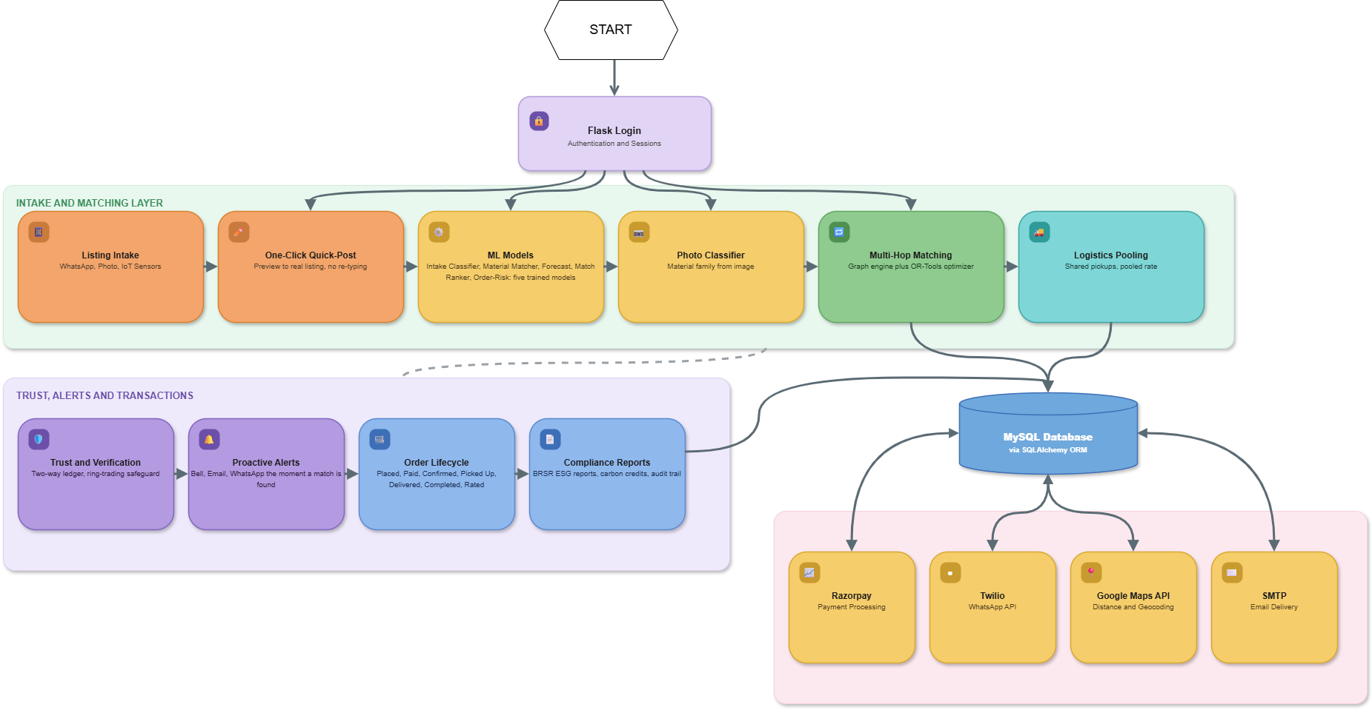
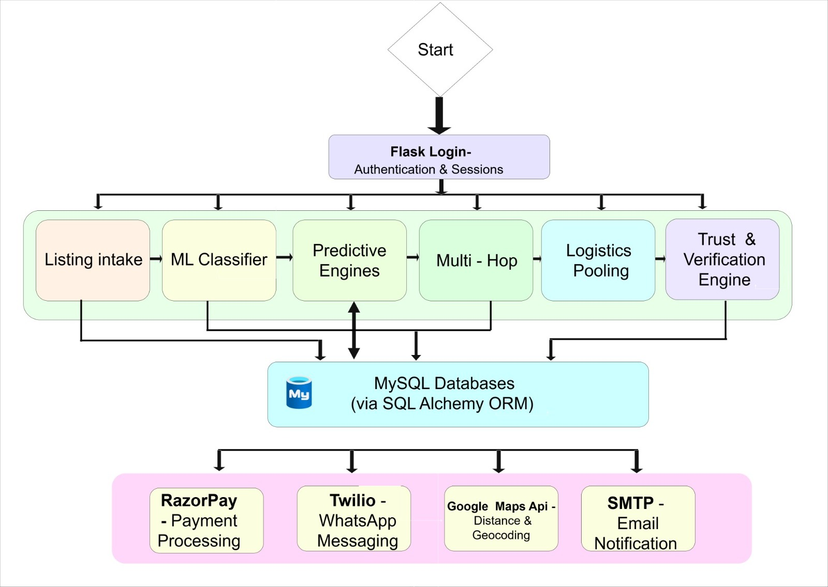
System Architecture
Request flow from login through the six business-logic modules to MySQL and the external services:
09

Slide 10
Why SymbioLink AI
 | Today | SymbioLink AI
Discovery | Word of mouth, local scrap dealers | AI-ranked matches across the whole cluster
Small loads | Skipped — not worth a solo trip | Pooled with nearby pickups automatically
Trust | No record of a stranger's reliability | Two-way rating ledger, visible before committing
Intake | Needs someone to actively search | One WhatsApp message or voice note
Records | Informal, no audit trail | Every step logged — real compliance trail
BENEFITS
Higher realized value for waste, lower raw-material cost
Continuous discovery, not one-time matching
Lower emissions from reuse + pooled transport
Zero app-literacy barrier via WhatsApp intake
CHALLENGES
Reference prices are estimates, not live market data
Cold-start: needs real listings from a pilot cluster
Cannot fully prevent direct off-platform contact
Retention comes from continuous new-match discovery, network-wide pooling, and audit-trail value — not from locking users in.
10

Slide 11
Feasibility & Validation
Not a claim — a working prototype with held-out results:
95.6%
0.725
+14.2%
120 / 120
Intake-classification accuracy
AUC — match ranking model
Forecast MAE improvement vs. baseline
Automated tests passing
FEASIBILITY
TECH STACK
All six layers already run end-to-end on a synthetic dataset modeled on real Indian clusters (Muzaffarnagar paper/sugar-mill belt, Mysore mixed-manufacturing).
Five real trained ML models now power intake parsing, forecasting, match ranking, photo-based material classification and order-risk prediction — each falls back to a heuristic automatically if untrained.
Google Maps + WhatsApp integrations are already wired in — go live with an API key, zero code changes.
Backend: Python · Flask · SQLAlchemy ORM
Database: MySQL (dev/prod) · in-memory SQLite (tests)
ML: scikit-learn — TF-IDF + Logistic Regression + Ridge + RandomForest
Integrations: Razorpay · Twilio WhatsApp API · Google Maps API · SMTP
Frontend: Jinja2 templates · Chart.js / vis-network
11

Slide 12
End-to-End Flow
1. Intake
5. Payment
A WhatsApp message hits the Twilio webhook; ML classifiers parse it into a Listing row.
Razorpay creates the order (real or simulated); verification marks the order paid in MySQL.
2. Discovery
6. Fulfillment
The matching engine ranks candidates by distance, savings and trust — including multi-hop chains.
The order advances confirmed → picked up → delivered → completed, each step logged.
3. Pooling check
7. Trust update
Small quantities are checked against nearby pickups to pool into one shared, cheaper trip.
Both sides rate each other — two TrustRating rows update the live trust score.
4. Order
8. Compliance
The buyer places an order — an Order + OrderItem row is written and logged to history.
Every step is queryable from /admin/audit — a full, real audit trail.
12

Slide 13
CONCLUSION
From informal, word-of-mouth exchange to a structured, AI-driven system.
SymbioLink AI is built on a real database, real payments, and a real multi-hop matching engine — ready to scale from two companies to an entire industrial cluster.
Economic
Environmental
Social
New revenue from waste, cheaper substitute inputs, extra savings from multi-hop matching and pooled transport.
Keeps material in circulation instead of landfill — cuts virgin-material extraction and pooled-transport emissions.
A transparent trust ledger builds confidence for owners historically excluded from digital marketplaces.
13

Slide 14
Thank You
Happy to answer questions or walk through any part of the platform again.
Team Name: Team Chaos
Problem Statement: SymbioLink AI — Clean & Green Technology

